Slide 1
Conceptual models
ECE 695
Alexander J. Quinn
January 27, 2016
Credit: These slides were modeled after slides by François Guimbretière

Slide 2
Credit: www.billrappsubaru.com

Slide 3
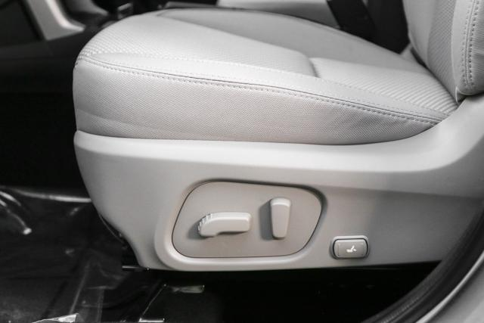
Credit: http://www.reevesimportmotorcars.com/brands/subaru/new/inventory/Vehicle/JF2SJADCXGH450123

Slide 4
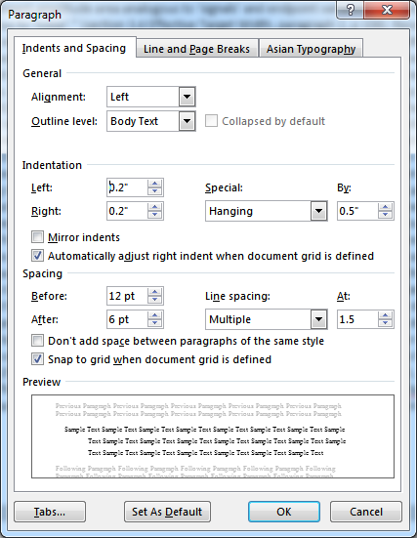
Gulf of execution
Execution
bridge
action
specification
interface
mechanism
intentions
goals
physical
system
interpretation
interface
display
evaluation
Evaluation
bridge
Credit: Don Norman, User Centered System Design: New Perspectives on Human-computer Interaction, 1986; vectorized by Alex Quinn

Slide 5
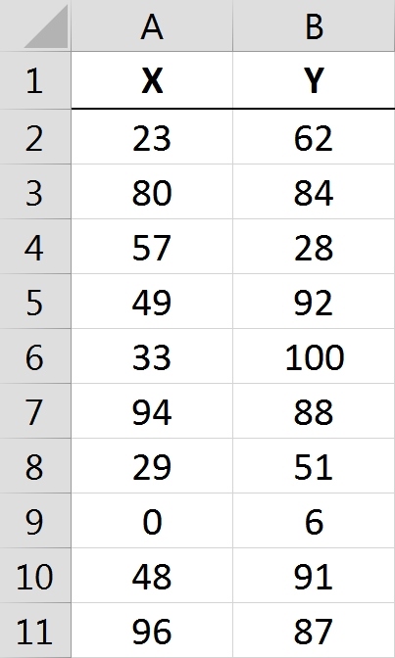
Gulf of execution: evaluation
correlated?

Slide 6
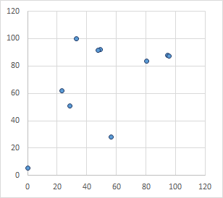
Gulf of execution: evaluation
correlated?

Slide 7
Gulf of execution: evaluation
ρ = -0.38
correlated?

Slide 8
Gulf of execution: action specification

Slide 9
Gulf of execution: action specification
“What is the correlation coefficient?”

Slide 10
Gulf of execution: action specification
“What is the correlation coefficient of the numbers in columns A and B of Sheet1 not including the headers?”

Slide 11
VIDEO:
Don Norman: The three ways that good design makes you happy

